Slide 1

Comfort
A Social Platform

Slide 2
The big picture
Building a platform that delivers "Positive Sentiment Nepali News"

Slide 3
Project Pipeline
Data Scraping
Data Cleaning
Labelling
Data Pre-processing
Feature Extraction
Model Training & Evaluation
Deployment

Slide 4
Project Pipeline
Data Scraping
Data Cleaning
Labelling
Data Pre-processing
Feature Extraction
Model Training & Evaluation
Deployment

Slide 5
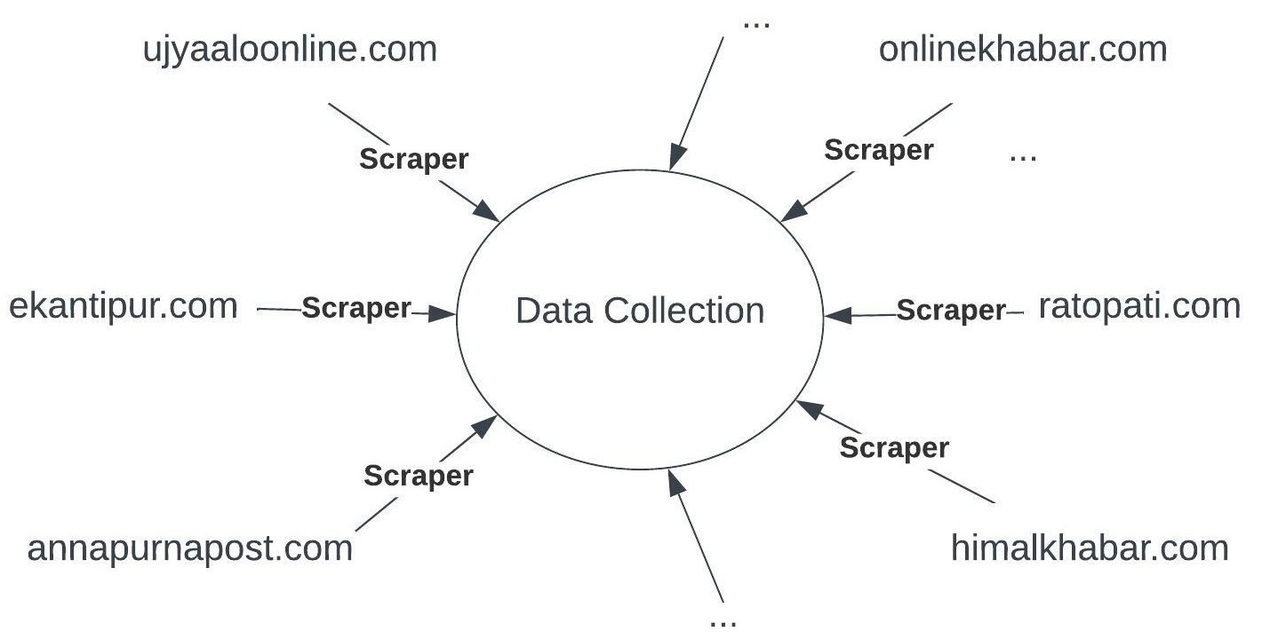
Data Scraping
Data Cleaning
Labelling
Feature Extraction
Deployment
Training & Evaluation
Preprocessing
Not Feasible
Notes:
Building the scraper for each news sites to collect the news is simply not feasible and maintainable, given the time constraints we had…

Slide 6
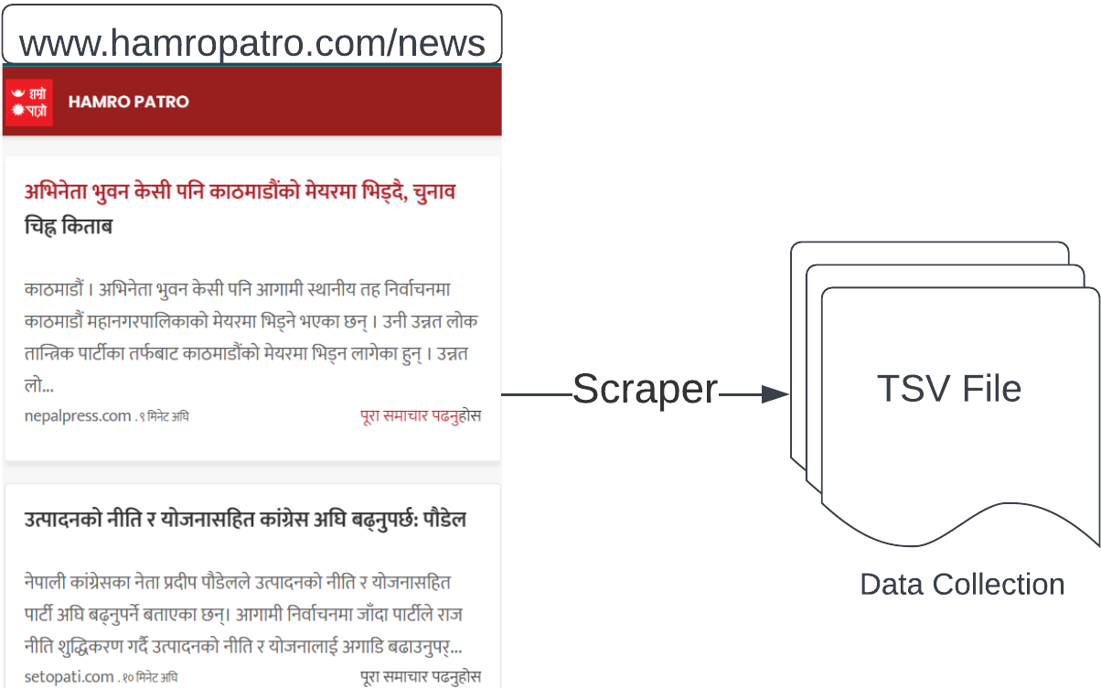
Data Scraping
Data Cleaning
Labelling
Feature Extraction
Deployment
Training & Evaluation
Preprocessing
Alternatively
Notes:
So, we instead built a scraper- particularly to scrape data from hampatro.com/news site, which collects the data and stores into a TSV file.

Slide 7
Data Scraping
Data Cleaning
Labelling
Feature Extraction
Deployment
Training & Evaluation
Preprocessing
A row of data from tsv file:
मोरङ झडपमा घाइते भएकी प्रहरी जवानको मृत्यु | काठमाडौं । मोरङको लेटाङमा स्थानीय र प्रहरीबीच भएको झडपमा घाइते भएकी प्रहरी जवान उर्मिला श्रेष्ठको मृत्यु भएको छ । प्रहरीले झडपका क्रममा उनीमाथि धारिलो हतियार... | baahrakhari.com | ७ घण्टा अघि | https://baahrakhari.com/news-details/344678
Taking headlines only:
मोरङ झडपमा घाइते भएकी प्रहरी जवानको मृत्यु
China under pressure amid countrywide COVID-19 resurgence
महाशिवरात्रीमा पशुपतिमा केएमसीको निःशुल्क स्वास्थ्य शिविर
देउवालाई अमेरिकी विदेशमन्त्रीको फोन, युक्रेनलाई समर्थन गरेकोबारे चासो
आकाशमुखी बजारमा
युक्रेनमाथि रूसी आक्रमणबारे प्रधानमन्त्री देउवा र अमेरिकी विदेश मन्त्रीबीच कुराकानी
Notes:
We proceed taking only the first column of tsv file i.e. headlines only and all other column data such as news summary, news source, upload time and news links are simply not taken into consideration for building model, but used later in the site.

Slide 8
Project Pipeline
Data Scraping
Data Cleaning
Labelling
Data Pre-processing
Feature Extraction
Model Training & Evaluation
Deployment

Slide 9
Data Scraping
Data Cleaning
Labelling
Feature Extraction
Deployment
Training & Evaluation
Preprocessing
Proceeded with more than 15 days of data ~ 4385 rows
मोरङ झडपमा घाइते भएकी प्रहरी जवानको मृत्यु​
China under pressure amid countrywide COVID-19 resurgence​
महाशिवरात्रीमा पशुपतिमा केएमसीको निःशुल्क स्वास्थ्य शिविर​
देउवालाई अमेरिकी विदेशमन्त्रीको फोन, युक्रेनलाई समर्थन गरेकोबारे चासो ​
आकाशमुखी बजारमा​
युक्रेनमाथि रूसी आक्रमणबारे प्रधानमन्त्री देउवा र अमेरिकी विदेश मन्त्रीबीच कुराकानी ​
Eliminated rows with news in English
More details on
next slide..
Removed rows with headlines
having word count < 4
Removed redundant rows

Slide 10
Coping with Redundancy
Shingling + Min-hashing
– A concept from IR

Slide 11
Data Cleaning:
Coping with Redundancy
Options for dealing with redundancy:
Highly infeasible!
Manually checking rows of data
Seems
Plausible!
Automate the process with Shingling + Min-Hashing
Character-level shingling with 5 consecutive characters representing a shingle
For instance,
Headline : 'देउवालाई अमेरिकी विदेशमन्त्रीको फोन ...'
Shingles : ['देउवा', 'ेउवाल', 'उवाला', 'वालाई', 'ालाई ', 'लाई अ', 'ाई अम', 'ई अमे', ' अमेर', 'अमेरि', ...,]

Slide 12
Data Cleaning:
Coping with Redundancy
# Working Assumption: Headlines having lots of shingles in common are similar
Built Shingle-Headline Matrix (
Applied Min-Hashing that resulted short Signature Matrix
Headline
 | H1 | H2 | ...
देउवा | 1 | 1 | ...
ेउवाल | 1 | 0 | ...
... | ... | ... | ...
अमेरि | 1 | 1 | ...
मेरिक | 1 | 1 | ...
... | ... | ... | ...
फोन, | 1 | 0 | ...
... | ... | ... | ...
H1 | H2 | ...
... | ... | ...
... | ... | ...
... | ... | ...
Shingle
(50 * 4385)
(61927 * 4385)
Using Jaccard Similarity and pre-set similarity threshold, removed ~38% redundant headlines

Slide 13
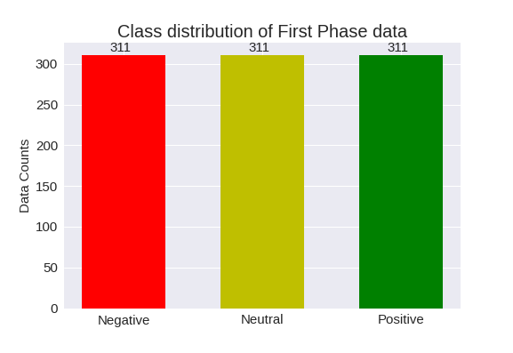
Data Scraping
Data Cleaning
Labelling
Feature Extraction
Deployment
Training & Evaluation
Preprocessing
Proceed with 2712 headlines, each categorized into Positive, Neutral, and Negative
933 rows of labelled data used for the First Phase

Slide 14
Project Pipeline
Data Scraping
Data Cleaning
Labelling
Data Pre-processing
Feature Extraction
Model Training & Evaluation
Deployment

Slide 15
Data Pre-processing
Removal of punctuations & numbers
Tokenization
Normalization
Stop word Removal
Stemming

Slide 16
Data Scraping
Data Cleaning
Labelling
Feature Extraction
Deployment
Training & Evaluation
Preprocessing
Removal of punctuations and numbers
For instance,
Before : ७७ जिल्लामै कांग्रेसले सक्यो अधिवेशन, कहाँ कसले जिते सभापति? (सूची)
After : जिल्लामै कांग्रेसले सक्यो अधिवेशन कहाँ कसले जिते सभापति सूची
Tokenization
For instance,
Before : जिल्लामै कांग्रेसले सक्यो अधिवेशन कहाँ कसले जिते सभापति सूची
After : ['जिल्लामै', 'कांग्रेसले', 'सक्यो', 'अधिवेशन', 'कहाँ', 'कसले', 'जिते', 'सभापति', 'सूची']

Slide 17
Data Scraping
Data Cleaning
Labelling
Feature Extraction
Deployment
Training & Evaluation
Preprocessing
Normalization : Each characters ['ऊ', 'व', 'श', 'ष', 'ू', 'ी', 'ँ', 'ई'] replaced with ['उ', 'ब', 'स', 'स', 'ु', 'ि', '', 'इ']
For instance,
Before : विद्युतीय राहदानी वितरण सेवालाई प्रभावकारी बनाउने निर्णय
After : बिद्युतिय राहदानि बितरण सेबालाइ प्रभाबकारि बनाउने निर्णय
Stop word Removal: Removed 255 commonly used Nepali stop words like ‘छ’, ‘र’, ‘पनि’, ‘छन्’, ‘लागि’, etc.

Slide 18
Data Scraping
Data Cleaning
Labelling
Feature Extraction
Deployment
Training & Evaluation
Preprocessing
Stemming:
Only Type-I suffix stripping is implemented
Post-positions such as ‘ले’, ‘बाट’ ‘लागि’ etc. and agglutinative suffixes like ‘हरुले’ in ‘हामीहरुले’ etc. are stripped out
For instance,
Before: उनीहरुले भने नेपालको मुख कहिलेपनि फ़ेर्ने छैन
After: उनि भने नेपाल मुख कहिले फ़ेर्ने छैन
With Pre-processing:
Stemming + Normalization reduced ~27% tokens
Stopword Removal + Stemming + Normalization reduced ~29% tokens

Slide 19
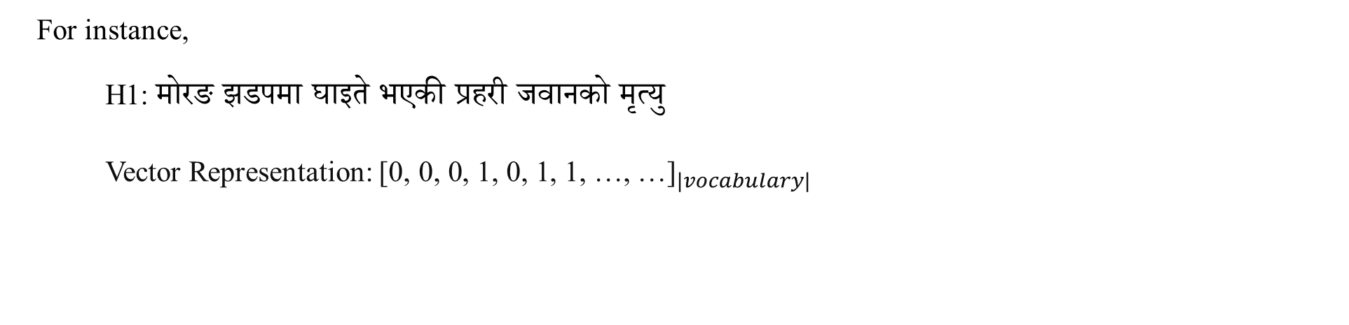
Data Scraping
Data Cleaning
Labelling
Feature Extraction
Deployment
Training & Evaluation
Preprocessing
Headline
Bag of Words model is followed where,
vocabulary = set of all words from preprocessed corpus
headline = a boolean/multiset feature vector of length
equal to |vocabulary|
 | H1 | H2 | ...
पशुपति | 0 | 0 | ...
देउवा | 0 | 1 | ...
फोन | 0 | 1 | ...
मृत्यु | 1 | 0 | ...
रूसी | 0 | 1 | ...
प्रहरी | 1 | 0 | ...
झडप | 1 | 0 | ...
... | ... | ... | ...
Vocabs
For instance,
H1: मोरङ झडपमा घाइते भएकी प्रहरी जवानको मृत्यु ​
Vector Representation: ${\text{[0, 0, 0, 1, 0, 1, 1, …, …]}}_{|vocabulary|}$

Slide 20
Project Pipeline
Data Scraping
Data Cleaning
Labelling
Data Pre-processing
Feature Extraction
Model Training & Evaluation
Deployment

Slide 21
Data Scraping
Data Cleaning
Labelling
Feature Extraction
Deployment
Training & Evaluation
Preprocessing
Model Training:
Bernoulli Event Model, Multinomial Event Model, and Logistic Regression are analyzed
Trained each model on 3 pre-processing schemes:
Raw headlines
Stemmed + Normalized headlines
Stopwords Removed + Stemmed + Normalized headlines
One-vs-rest technique is followed
Evaluation:
Used 5 fold cross validation for evaluation
Multinomial Event Model outperformed other classifiers, though not by much
Stemmed+Normalized scheme performed better with an average F1-score of .61on Multinomial Event Model
Removing Stop words has not much significance

Slide 22
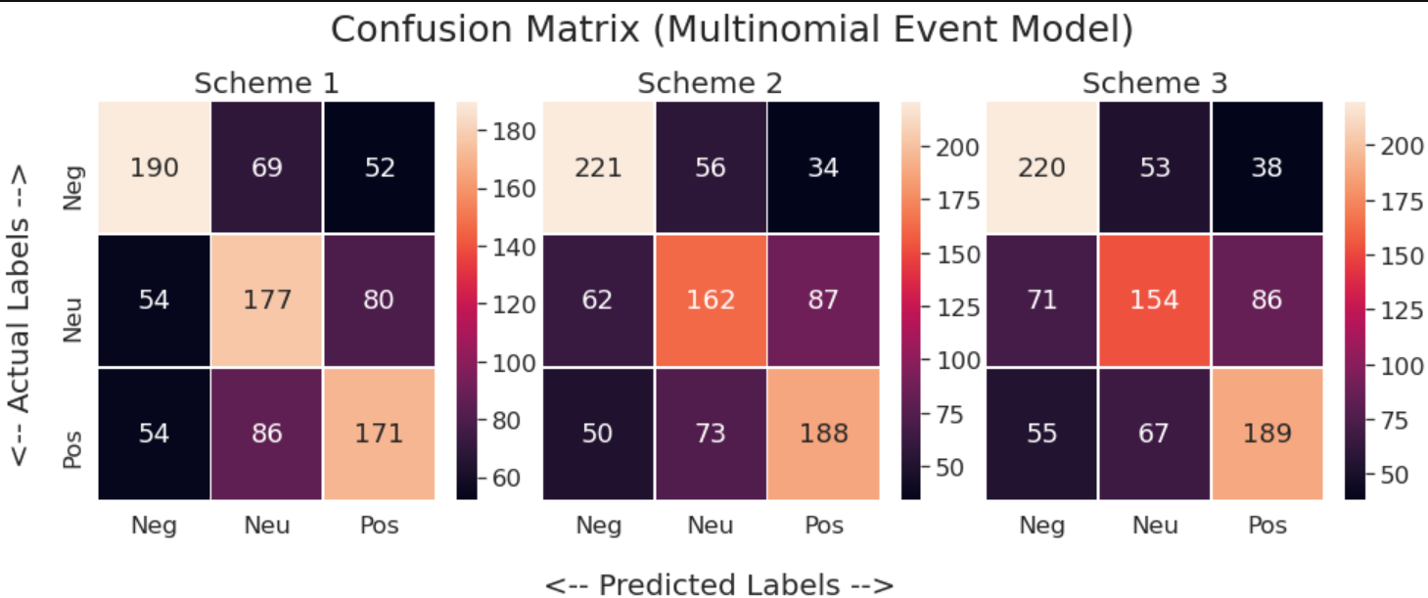
Data Scraping
Data Cleaning
Labelling
Feature Extraction
Deployment
Training & Evaluation
Preprocessing
Evaluation continued…
Classifiers classified Negative news more correctly in most cases
False Negatives and False Positives for Negative class were minimal than for any other labels

Slide 23
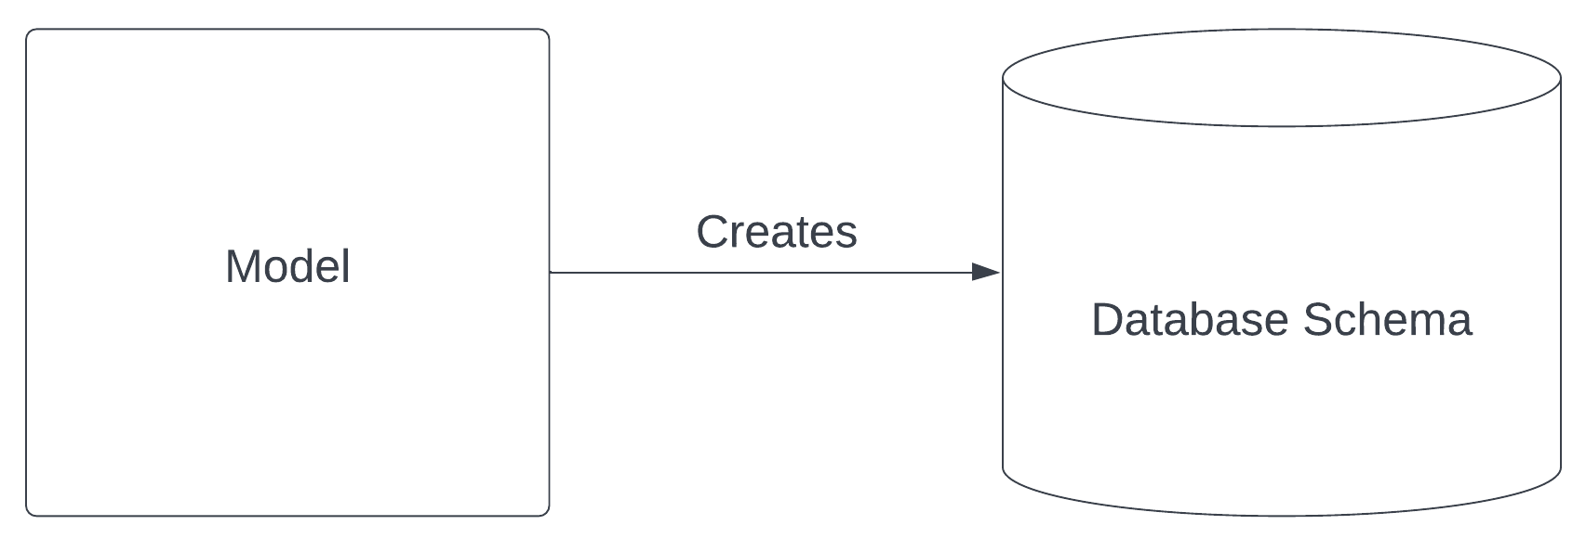
Data Scraping
Data Cleaning
Labelling
Feature Extraction
Deployment
Training & Evaluation
Preprocessing
Deploying into Web:
Used Django–python’s web framework
MySQL as a database server
Front-end technologies like HTML, CSS, and JS
Followed MVC architecture
Database Operations
Table Creation

Slide 24
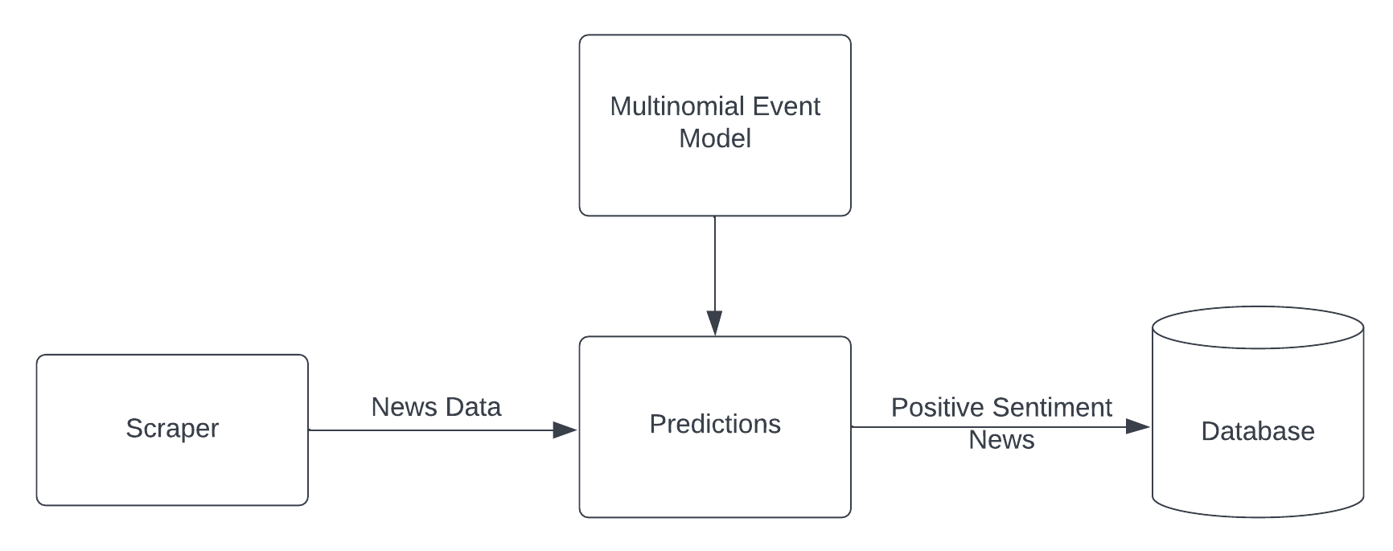
Data Scraping
Data Cleaning
Labelling
Feature Extraction
Deployment
Training & Evaluation
Preprocessing
Insertion into Database

Slide 25
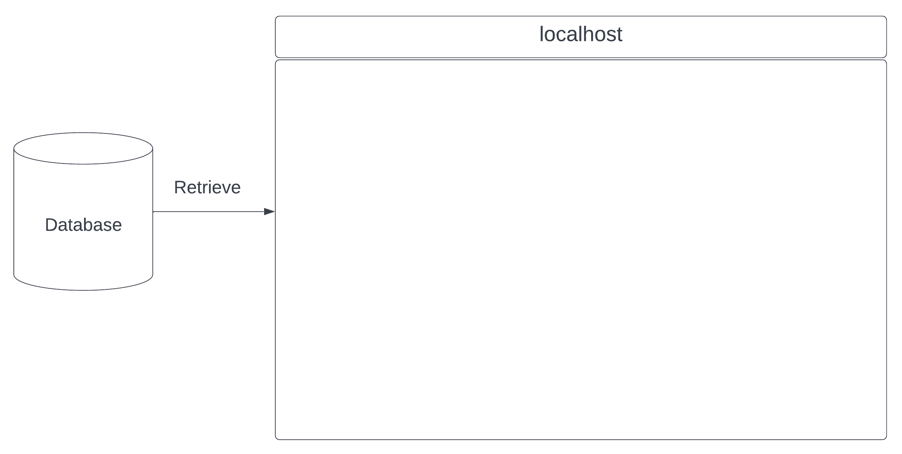
Data Scraping
Data Cleaning
Labelling
Feature Extraction
Deployment
Training & Evaluation
Preprocessing
Retrieval from Database

Slide 26
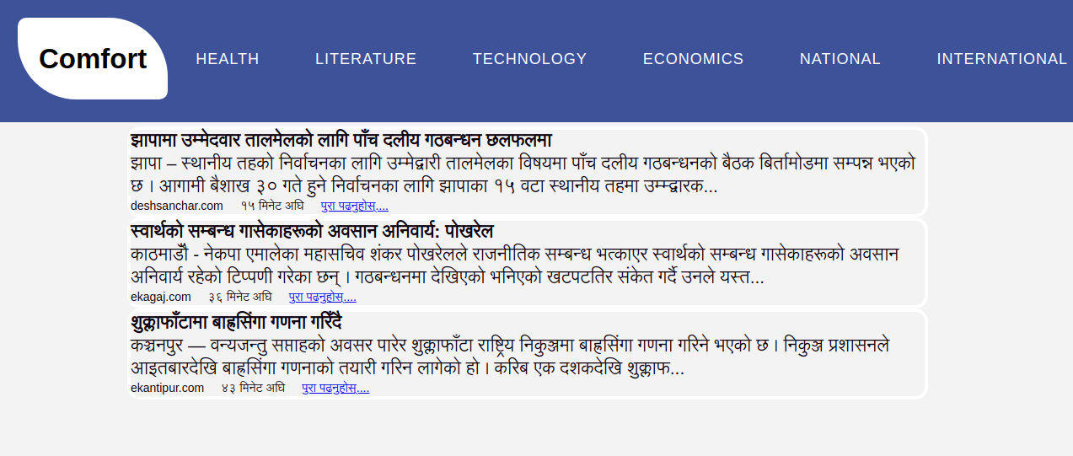

Data Scraping
Data Cleaning
Labelling
Feature Extraction
Deployment
Training & Evaluation
Preprocessing
Final Web Interface

Slide 27
Live Demo

Slide 28
Supplementary Slide…
Top 5 indicative words
Negative Class
Neutral Class
Positive Class
मृत्यु
कारण
रुस
रुसि
हत्या
रिलिज
चुनाबि
लिभरपुल
बराबरि
आलिया
दिबस
निःसुल्क
नारि
खुसि
सम्मानित

Slide 29
Future Works
Building a full-scale crawler
Enhancing the Nepali-stemmer
Making training data more reliable with strict definitions
Testing with more sophisticated models like Neural nets and kernels

Slide 30
The End
Team members:
Bijay Adhikari (16622/074)
Amrit Sharma (16613/074)
Nirajan Kamar (16642/074)

